Slide 1
UNIT 1
INTRODUCTION TO OPERATING SYSTEM
CO 1: Explain operating
system

Slide 2
Hardware
Software
Application Software
System Software
Utility Software
Programs

Slide 3
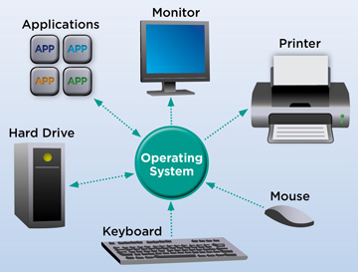
OPERATING SYSTEM
An operating system (OS) is system software that manages computer hardware, software resources and provides common services for computer programs.

Slide 4
Types of Operating System (OS)
Following are the popular types of Operating System:
Batch Operating System
Multitasking/Time Sharing OS
Real Time OS
Distributed OS
Network OS
Mobile OS
Batch Operating System
Some computer processes are very lengthy and time-consuming.
To speed the same process, a job with a similar type of needs
are batched together and run as a group.
The user of a batch operating system never directly interacts
with the computer

Slide 5
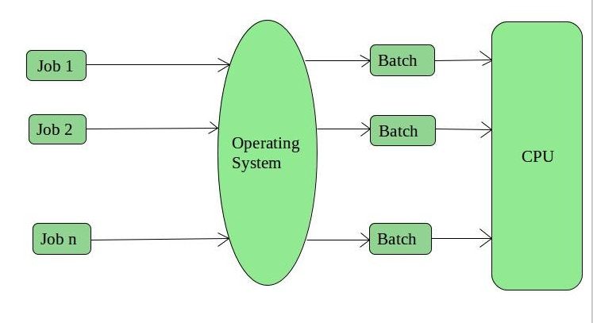
In this type of OS, every user prepares his or her job on an offline device like a punch card and submit it to
the computer operator.

Slide 6
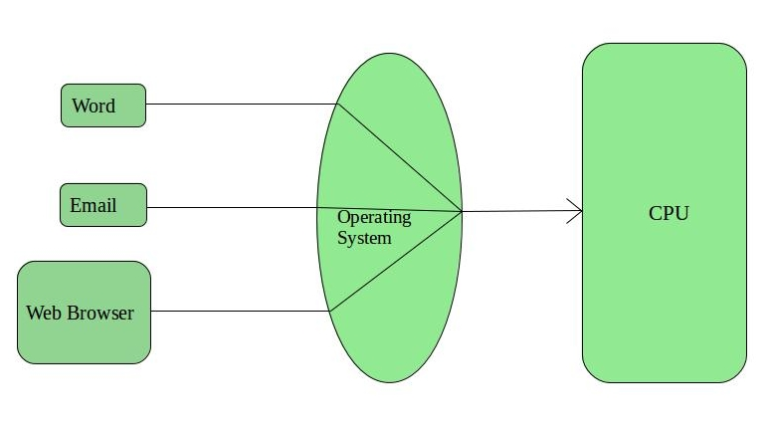
Multitasking/Time Sharing OS
Time-sharing operating system enables people located at a
different terminal(shell) to use a single computer system at the
same time.
The processor time (CPU) which is shared among multiple
users is termed as time sharing.

Slide 7
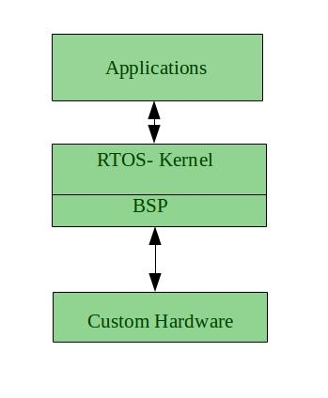
Real Time OS
A real time operating system time interval to process and
respond to inputs is very small.
Examples: Military Software Systems, Space Software Systems
are the Real time OS example.

Slide 8
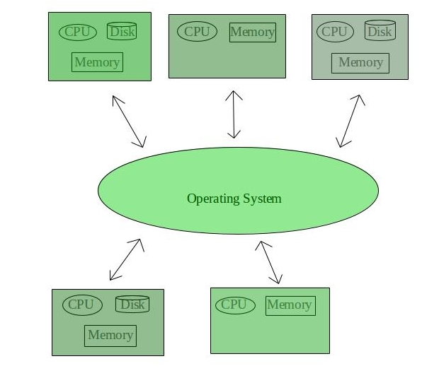
Distributed OS
Distributed systems use many processors located in different
machines to provide very fast computation to its users.

Slide 9
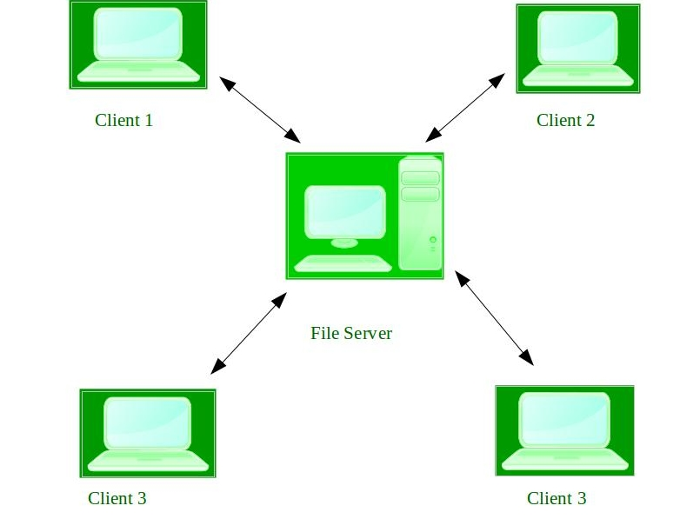
Network OS
Network Operating System runs on a server.
It provides the capability to serve to manage data, user, groups, security, application, and other networking functions.

Slide 10
Mobile OS
Mobile operating systems are those OS which is especially that
are designed to power smartphones, tablets, and wearables devices.
The Five Most Popular Operating Systems
Microsoft Windows.
Apple macOS.
Google's Android OS
Apple iOS.
Linux Operating System.

Slide 11
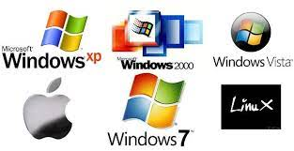
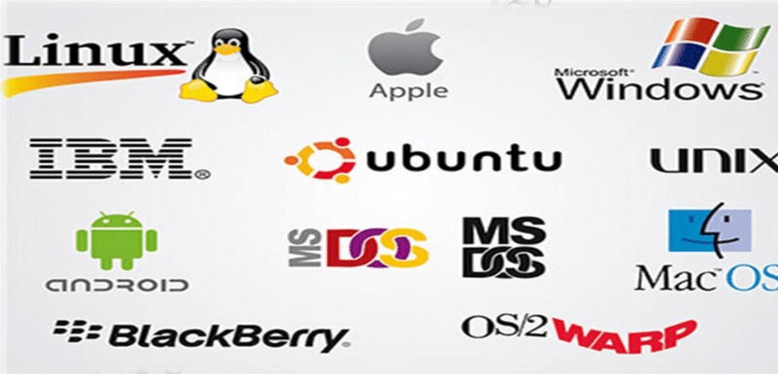

Slide 12
Define the following
Software
Hardware
Programs
2. List the Operating system Examples.
3. List Popular Platforms of Mobile OS.
4. Define Operating System

Slide 13
Unit 1: Introduction to OS
What Operating Systems Do
Computer-System Organization
Computer-System Architecture
Operating-System Structure
Operating-System Operations
Process Management
Memory Management
Storage Management
Protection and Security
Computing Environments
Open-Source Operating Systems

Slide 14
Objectives
To describe the basic organization of computer systems
To provide a grand tour of the major components of operating systems
To give an overview of the many types of computing environments
To explore several open-source operating systems

Slide 15
What is an Operating System?
A program that acts as an intermediary between a user of a computer and the computer hardware
Operating system goals:
  Execute user programs and make solving user problems easier
  Make the computer system convenient to use
  Use the computer hardware in an efficient manner
OS is a resource allocator
  Manages all resources
  Decides between conflicting requests for efficient and fair resource use
OS is a control program
  Controls execution of programs to prevent errors and improper use of the computer
  “The one program running at all times on the computer” is the kernel.

Slide 16
What Operating Systems Do
Depends on the point of view
Users want convenience, ease of use and good performance
  Don’t care about resource utilization
But shared computer such as mainframe or minicomputer must keep all users happy
Users of dedicate systems such as workstations have dedicated resources but frequently use shared resources from servers
Handheld computers are resource poor, optimized for usability and battery life
Some computers have little or no user interface, such as embedded computers in devices and automobiles

Slide 17
Computer System Structure
Computer system can be divided into four components:
  Hardware – provides basic computing resources
    CPU, memory, I/O devices
  Operating system
    Controls and coordinates use of hardware among various applications and users
  Application programs – define the ways in which the system resources are used to solve the computing problems of the users
    Word processors, compilers, web browsers, database systems, video games
  Users
    People, machines, other computers

Slide 18

Four Components of a Computer System

Slide 19
Operating System can be explored in two view points
User view
System view
Computer-System Architecture
A computer system may be organized in a number of different ways and which can be categorized according to the number of general – purpose processors used.
i. Single processor systems
ii. multiprocessor systems
iii. Clustered systems

Slide 20
Single Processor Systems
It range from PDA’s through mainframes.
They consists of one main CPU capable of executing a general purpose instruction set, including instructions from user processes.
It consists of special purpose processors like device-specific processors such as disk, keyboard and graphics controller.
On mainframes there are general purpose processors like I/O processors that move data rapidly among the components of the system.
Special purpose processors run a limited instruction set and do not run user processes.
These are managed by the OS, i,e the OS sends them information about their next task and monitors their status

Slide 21
Multiprocessors systems growing in use and importance
  Also known as parallel systems, tightly-coupled systems
  Advantages include:
    Increased throughput – By more number of processors more work can be expected to be done in less time.
    Economy of scale – Multiprocessor system can cost less than equivalent multiple single-processor systems.
    Increased reliability – If functions can be distributed properly among several processors then the failure of one processor will not halt the system but only slow it down.
  Two types:
    Asymmetric Multiprocessing – each processor is assigned a specific task. (Master-Slave)
    Symmetric Multiprocessing – each processor performs all tasks within the OS(Peers)

Slide 22

Symmetric Multiprocessing Architecture
Advantage : Many processes can run simultaneously- N processes can run if there are N CPUs- without minimizing the performance
Disadvantage :
I/O must be controlled carefully to ensure that the data reaches to the appropriate processor.
As CPU’s are separate, some may be idle, while others are overloaded, resulting in inefficiencies.

Slide 23
Clustered Systems
Like multiprocessor systems, but multiple systems working together
  Usually sharing storage via a local-area network (LAN)
  Provides a high-availability service which survives failures
    Asymmetric clustering has one machine in hot-standby mode, while the other is running the applications.
    Symmetric clustering has multiple nodes running applications, monitoring each other
  Some clusters are for high-performance computing (HPC)
    Applications must be written to use parallelization
  Some have distributed lock manager (DLM) to avoid conflicting operations

Slide 24

Clustered Systems

Slide 25
Operating System Structure
Multiprogramming (Batch system) needed for efficiency
  Single user cannot keep CPU and I/O devices busy at all times
  Multiprogramming organizes jobs (code and data) so CPU always has one to execute
  A subset of total jobs in system is kept in memory
  One job selected and run via job scheduling
  When it has to wait (for I/O for example), OS switches to another job
Timesharing (multitasking) is logical extension in which CPU switches jobs so frequently that users can interact with each job while it is running, creating interactive computing
  Response time should be < 1 second
  Each user has at least one program executing in memory process
  If several jobs ready to run at the same time  CPU scheduling
  If processes don’t fit in memory, swapping moves them in and out to run
  Virtual memory allows execution of processes not completely in memory

Slide 26

Memory Layout for Multiprogrammed System

Slide 27
Operating-System Operations
OS are Interrupt driven (hardware and software)
  Hardware interrupt by one of the devices
  Software interrupt (exception or trap):
    Software error (e.g., division by zero)
    Request for operating system service
    Other process problems include infinite loop, processes modifying each other or the operating system

Slide 28
Dual mode Operation
Dual-mode operation allows OS to protect itself and other system components
  User mode and kernel mode
  Mode bit provided by hardware kernel(0), User (1)
    Provides ability to distinguish when system is running user code or kernel code
    Some instructions designated as privileged, only executable in kernel mode
    System call changes mode to kernel, return from call resets it to user
Increasingly CPUs support multi-mode operations
  i.e. virtual machine manager (VMM) mode for guest VMs

Slide 29

Transition from User to Kernel Mode
Timer to prevent infinite loop / process hogging resources
  Timer is set to interrupt the computer after some time period
  Keep a counter that is decremented by the physical clock.
  Operating system set the counter (privileged instruction)
  When counter zero generate an interrupt
  Set up before scheduling process to regain control or terminate program that exceeds allotted time

Slide 30
Process Management
A process is a program in execution. It is a unit of work within the system. Program is a passive entity, process is an active entity.
Process needs resources to accomplish its task
  CPU, memory, I/O, files
  Initialization data
Process termination requires reclaim of any reusable resources
Single-threaded process has one program counter specifying location of next instruction to execute
  Process executes instructions sequentially, one at a time, until completion
Multi-threaded process has one program counter per thread
Typically system has many processes, some user, some operating system running concurrently on one or more CPUs
  Concurrency by multiplexing the CPUs among the processes / threads

Slide 31
Process Management Activities
The operating system is responsible for the following activities in connection with process management:
Creating and deleting both user and system processes
Suspending and resuming processes
Providing mechanisms for process synchronization
Providing mechanisms for process communication
Providing mechanisms for deadlock handling
Scheduling processes and threads on the CPU’s

Slide 32
Memory Management
To execute a program all (or part) of the instructions must be in memory
All (or part) of the data that is needed by the program must be in memory.
Memory management in general-purpose computers is necessary to improve two things:
Utilization of CPU Speed of the computer’s response to the user.
determines what is in memory and when
  Optimizing CPU utilization and computer response to users
Memory management activities
  Keeping track of which parts of memory are currently being used and by whom
  Deciding which processes (or parts thereof) and data to move into and out of memory
  Allocating and deallocating memory space as needed

Slide 33
Storage Management
OS provides uniform, logical view of information storage
  Abstracts physical properties to logical storage unit - file
  Each medium is controlled by device (i.e., disk drive, tape drive)
    Varying properties include access speed, capacity, data-transfer rate, access method (sequential or random)
File-System management
  Files usually organized into directories
  Access control on most systems to determine who can access what
  Characteristics :
  access speed, Capacity, Data transfer rate ,Access method
  OS activities include
    Creating and deleting files and directories
    Primitives to manipulate files and directories
    Mapping files onto secondary storage
    Backup files onto stable (non-volatile) storage media

Slide 34
Mass-Storage Management
Usually disks used to store data that does not fit in main memory or data that must be kept for a “long” period of time
Proper management is of central importance
Entire speed of computer operation hinges on disk subsystem and its algorithms
OS activities
  Free-space management
  Storage allocation
  Disk scheduling
Some storage need not be fast
  Tertiary storage includes optical storage, magnetic tape
  Still must be managed – by OS or applications
  Varies between WORM (write-once, read-many-times) and RW (read-write)

Slide 35
Functions
Provide mounting and unmounting media in devices
Allocating and freeing the device for exclusive use by processes
Migrating data from secondary to tertiary storage
Caching
Information is kept in the storage system as main memory
To use it is copied into a faster storage system called the cache on a temporary basis.
To get a particular piece of information, the cache is checked first.
If it is in cache, the information is used directly from the cache, if it is not the information is used from the source, putting a copy in the cache under the assumption that it will may be needed again soon.
Without cache the CPU would have to wait several cycles while an instruction was fetched from main memory

Slide 36

Performance of Various Levels of Storage
Movement between levels of storage hierarchy can be explicit or implicit

Slide 37

Migration of data “A” from Disk to Register
Multitasking environments must be careful to use most recent value, no matter where it is stored in the storage hierarchy
Multiprocessor environment must provide cache coherency in hardware such that all CPUs have the most recent value in their cache
Distributed environment situation even more complex

Slide 38
I/O Subsystem
One purpose of OS is to hide peculiarities of hardware devices from the user
I/O subsystem responsible for
  Memory management of I/O including buffering (storing data temporarily while it is being transferred), caching (storing parts of data in faster storage for performance), spooling (the overlapping of output of one job with input of other jobs)
  General device-driver interface
  Drivers for specific hardware devices – The device drivers know

Slide 39
Protection and Security
Protection – any mechanism for controlling access of processes or users to resources defined by the OS
Security – defense of the system against internal and external attacks
  Huge range, including denial-of-service, worms, viruses, identity theft, theft of service
Systems generally first distinguish among users, to determine who can do what
  User identities (user IDs, security IDs) include name and associated number, one per user
  User ID then associated with all files, processes of that user to determine access control
  Group identifier (group ID) allows set of users to be defined and controls managed, then also associated with each process, file
  Privilege escalation allows user to change to effective ID with more rights

Slide 40
DISTRIBUTED SYSTEMS
Distributed Systems Is A Collection Of Physically Separate, Heterogeneous Computer Systems That Are Networked To Provide The Users With Access To The Various Resources Maintained By The System.
Access to shared resources increases
Computation speed
Functionality
Data availability
Reliability

Slide 41
A network is a communication path between two or more systems. Distributed systems depend on networking for their functionality.
Network vary-
by the protocols used
the distances between nodes
the transport media
Protocols : To an operating system, a network protocol needs an interface device called as network adapter.
Distance between nodes: Networks are characterized based on the distance between their nodes as LAN, WAN, MAN
Transport Media: The media used in networks to carry information, include copper wires, fiber stands and wireless transmissions between satellites, microwave dishes and radios.

Slide 42
SPECIAL PURPOSE SYSTEMS
Real Time Embedded Systems
Multimedia Systems
Handheld Systems
Real Time Embedded Systems
Embedded Systems are found everywhere from car engines and manufacturing robots to DVD’s and microwave ovens.
They have specific task
The systems they run on are primitive, so the OS provide limited features
They do not have user interface
They spend their time monitoring and managing hardware devices like automobile engines and robotics arms.
These embedded systems are of two types
They could be general purpose computers running standard OS like UNIX with special purpose applications to implement the functionality
2. Hardware devices with a special purpose embedded OS providing only the functionality required.

Slide 43
Multimedia Systems
Multimedia data consists of audio and video files and also conventional files. These data differ from conventional data in that multimedia data-such as frames of video must be delivered according to certain time restrictions.
Multimedia applications include MP3,DVD movies, video conferencing, short video clips, news stories, downloaded, live web casts, broadcasting over the WWW, speeches or sporting events and live web cams.
Handheld Systems
Handheld Systems include PDA’s like Palmtop and Pocket PC’s and cellular telephones which use special purpose embedded OS.
Limitations
The amount of physical memory is typically between 1MB and 1 GB. The OS and applications must manage memory efficiently.
The speed of the processor of the handheld devices is another issue. Faster processor require more power.
Another issue to be considered for handheld devices is I/O.

Slide 44
Computing Environments - Traditional
Stand-alone general purpose machines
Remote access also existed and portability was achieved by use of laptop computers
Portals provide web access to internal systems
Network computers (thin clients) are like Web terminals
Mobile computers interconnect via wireless networks
Networking becoming ubiquitous – even home systems use firewalls to protect home computers from Internet attacks

Slide 45

Computing Environments – Client-Server
Client-Server Computing
  Many systems now servers, responding to requests generated by clients
    Compute-server system provides an interface to client to request services (i.e., database)
    File-server system provides interface for clients to store and retrieve files

Slide 46

Computing Environments - Peer-to-Peer
Another model of distributed system
P2P does not distinguish clients and servers
  Instead all nodes are considered peers
  May each act as client, server or both
  Node must join P2P network
    Registers its service with central lookup service on network, or
    Broadcast request for service and respond to requests for service via discovery protocol
  Examples include Napster and Gnutella, Voice over IP (VoIP) such as Skype

Slide 47
Computing Environments Web-Based Computing
Web computing has increased the emphasis on networking
Devices that are include wired or wireless access to the internet.
The implementation of web based computing has given rise to
new categories of devices such as load balances, which
distribute network connections among a pool of similar servers.
OS like Windows 95 which acted as web-clients have evolved
into Linux and Windows XP which can act as web servers as
well as clients.
Web has increased the complexity of devices because their users
require them to be web enabled.

Slide 48
Open-Source Operating Systems
Operating systems made available in source-code format rather than just binary closed-source
Counter to the copy protection and Digital Rights Management (DRM) movement
Started by Free Software Foundation (FSF), which has “copyleft” GNU Public License (GPL)
Examples include GNU/Linux and BSD UNIX (including core of Mac OS X), and many more
Can use VMM like VMware Player (Free on Windows), Virtualbox (open source and free on many platforms - http://www.virtualbox.com)
  Use to run guest operating systems for exploration
  Some examples : Linux, BSD UNIX, Solaris,Utility

